Slide 1
Sapification
Fejér Norbert
Elekes Attila
Számítástechnika III. A

Slide 2
Main objectives
Creating a dynamic notification management platform
1
Realizing user friendly interface
2
Making available for everyone
3
Implementing only relevant features
4
Developing easily maintainable software
4
5

Slide 3
Realized project
Server
Data management
Web interface
Android App
Lots of testing....

Slide 4




Server
Data management: MariaDB, Firebase
RESTful web service
Storing meaningful datas
Managing notifications

Slide 5




Web
User ineraction
Notification history
User management
Topic management
Different settings
$62,000
Get a modern PowerPoint Presentation that is beautifully designed. I hope and I believe that this Template will your Time, Money and Reputation.

Slide 6
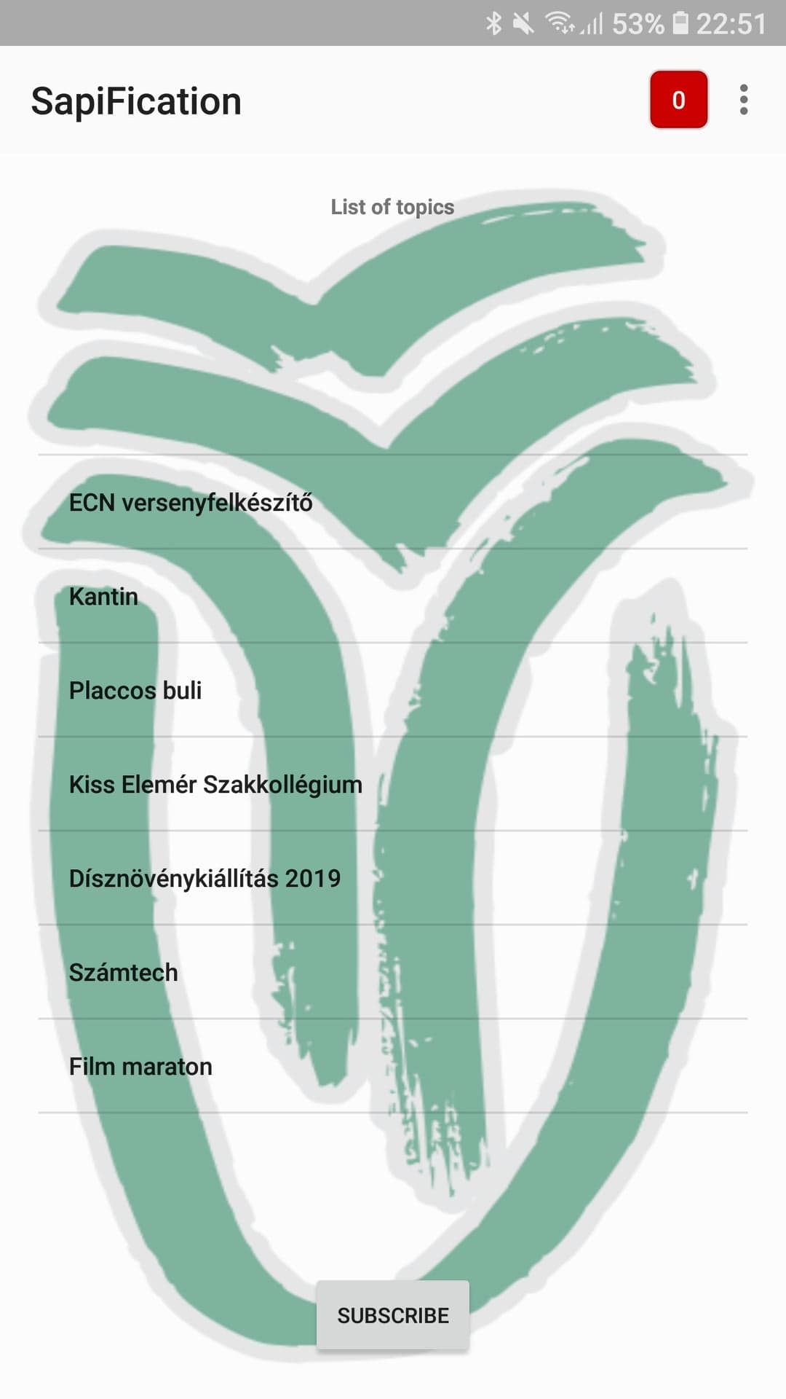
Android
Compactness
0-24 H availibility
Better comfortability
Keeping yourself up to date with news

Slide 7
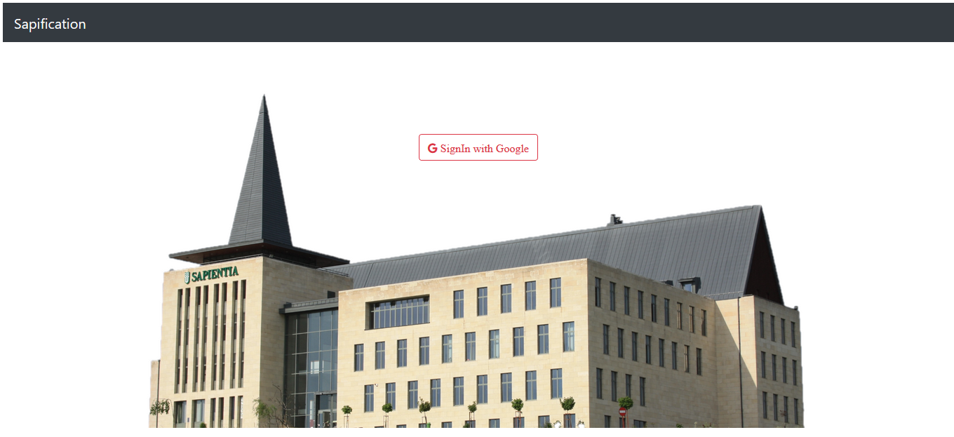
Live demo

Slide 8
Thank You
for Your attention!

